Slide 2






amazon

Slide 3
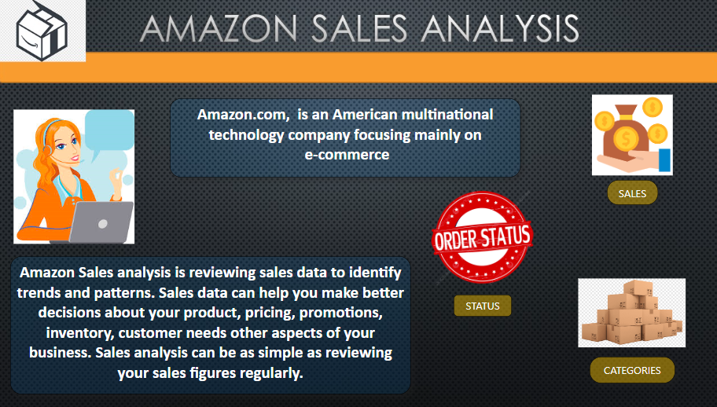

Slide 4
Business Motivation & Question
Customer behaviour regarding order rejection
How likely a purchase made will be rejected and what triggers these rejections?

Slide 5
Goals

Slide 6

Goals
Determine the possibility that the customer will reject the order

Slide 7

Goals
Determine the possibility that the customer will reject the order
Examine the Order Rejection by Shipment Level

Slide 8

Goals
Determine the possibility that the customer will reject the order
Examine the Order Rejection by Shipment Level
Evaluate the sales to see which products were the most popular.

Slide 9
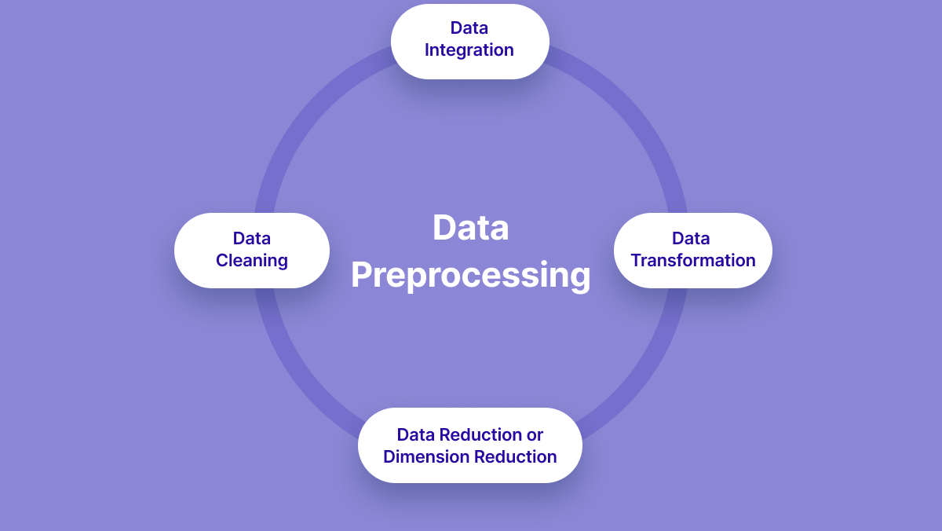

Slide 10




Data integration refers to the process of combining and merging data from different sources into a unified dataset.

Slide 11
Data set
Index
Order ID
Date
Status
Fulfilment
Sales Channel
Service-level
Style
SKU
Ship-postal-code
Ship-country
Promotion-ids
Category
Size
ASIN
Courier Status
Qty
Surrency
Amount
Ship-city
Ship-state
B2B
Fulfilled-by
Unnamed:22
SIZE OF DATA SET
ROWS :12,8975

Slide 12
Handling Missing Values
Dealing with Duplicates
Addressing Typos and Spelling Errors
Removing Irrelevant Information

Slide 13



Encoding: Convert categorical variables into numerical representations. Common techniques include one-hot encoding, label encoding.
Imputation: Fill in missing values using imputation techniques. Common methods include mean, median, or mode imputation
Handling Outliers : Apply transformations (e.g., log transformation) to mitigate the impact of outliers, or consider removing outliers if they significantly affect the performance of the model

Slide 14
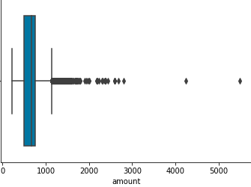
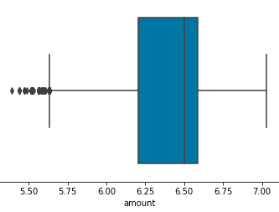
After removing Outliers

Slide 15
Data Sampling:
Random Sampling: Select a representative subset of the data randomly. This can be useful for large datasets where using the entire dataset may be computationally expensive.

Slide 16
Data set
Status
Fulfilment
Service-level
Ship-country
Fulfilled-by
Category
Size
Amount
Ship-state
B2B
SIZE OF DATA SET
ROWS :8,168

Slide 17

SPLITTING THE DATA SET & FITTING INTO MODEL
Identify the Target variable
Split the Data into X_Train,X_Test,Y_Train,Y_Test
Now Fit into the ML MODEL

Slide 18
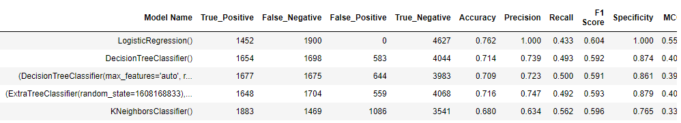

Slide 19
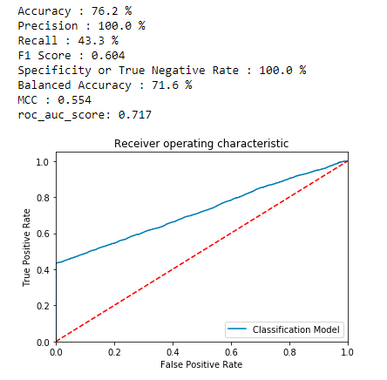
BEST ML MODEL
LogisticRegression
Binary Classification:
Logistic Regression is particularly suitable for binary classification problems, where the target variable has two possible outcomes (e.g., spam or not spam, fraud or not fraud).
Probability Estimation:
Logistic Regression provides probabilities for class membership, making it useful when you need not only the predicted class but also the confidence level.
Interpretability:
The model's coefficients can be interpreted in terms of the impact of each feature on the predicted probability. This makes it easy to explain the model's decisions to non-technical stakeholders.

Slide 20
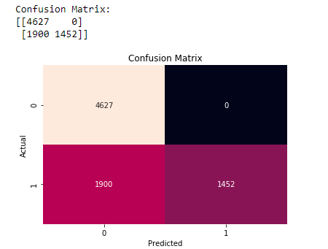
TP
FP
TP-True Positive
FP-False Positive
TN-True Negative
FN-False Negative
FN
TN

Slide 21
Conclusion
Most of the Rejections are based on :

Slide 22
Conclusion
Most of the Rejections are based on :
SHIPMENT – FULFILLMENT

Slide 23
Conclusion
Most of the Rejections are based on :
SHIPMENT – FULFILLMENT
SHIPMENT – SERVICELEVEL

Slide 24
Conclusion
Most of the Rejections are based on :
SHIPMENT – FULFILLMENT
SHIPMENT – SERVICELEVEL
PRICE

Slide 25
Thank You

